Slide 1
Shyama Prasad Mukherji
Rurban Mission (SPMRM)
Spatial Plan
Indicative Land Use and Master plan for Rurban Clusters
RURAL DEVELOPMENT DEPARTMENT - TELANGANA

Slide 2
Content of the Presentation
Clusters Planning details
Spatial Plan preparation Methodology
Plan Preparation Status
Planning Area Notification
Spatial Plan: Rykal
Regional Setting
Demand Gap Analysis & Projection
Spatial Plan
Existing Land Use

Slide 3
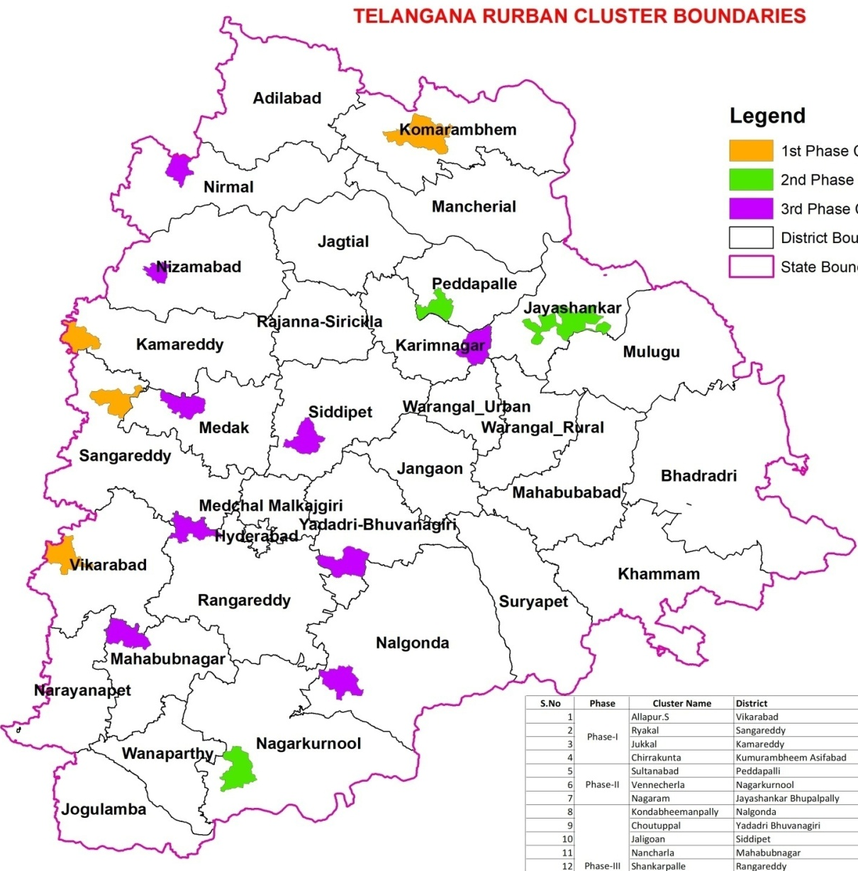
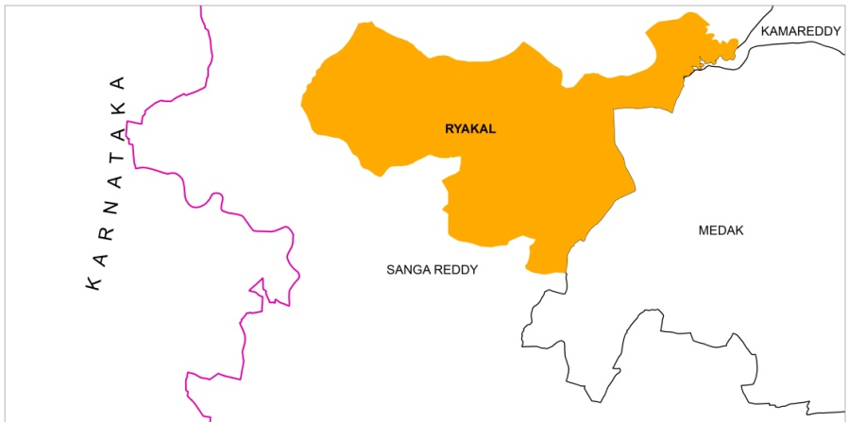
Telangana Rurban Cluster
3

Slide 4
Rurban Clusters: Spatial Plan
Objective
Zoning of Land Uses
Development controls
Enforcement machanism
PRI participation
Process
Cadastral Maps
Manual
Digital
Grama Sabha
Dist Planning Committee
Notification
Aim
Planned Growth
Suggestive
Preventive
Enforcement

Slide 5
Spatial Plan: Progress
Zoning regulation is being prepared and notified along with Master Plan

Slide 6
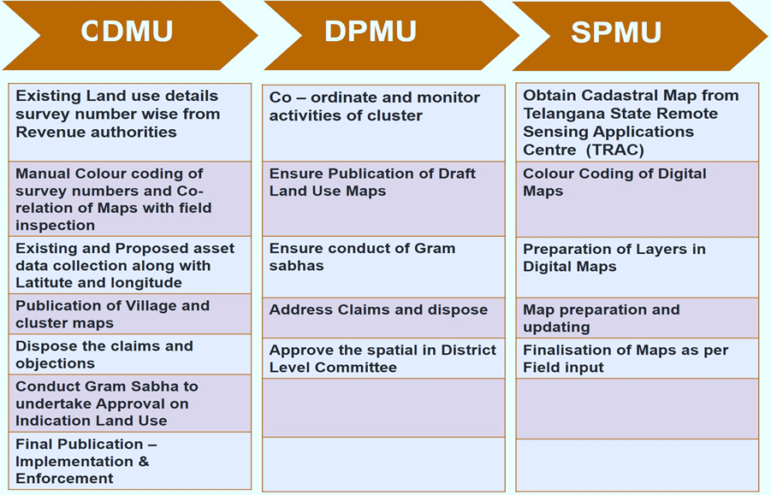
Spatial Plan: Role and Responsibility

Slide 7
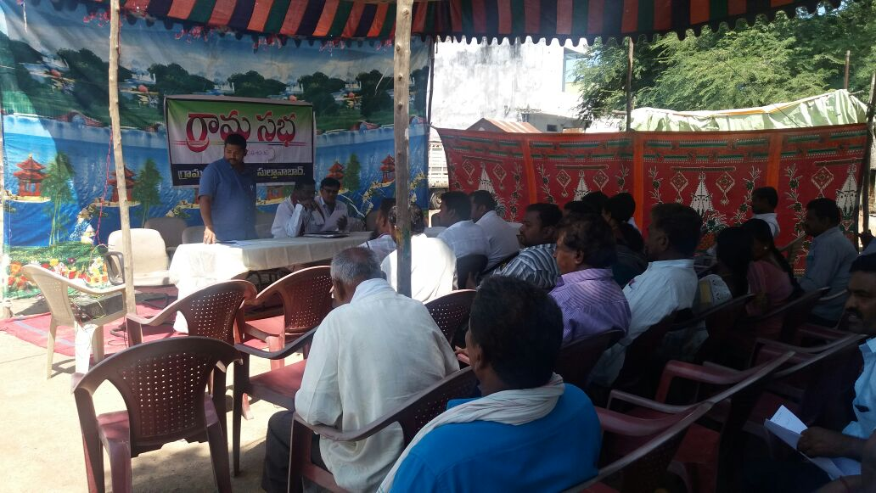
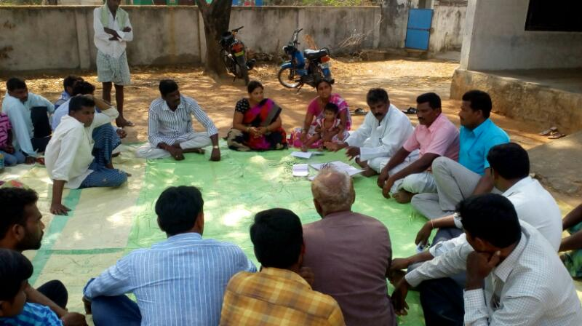
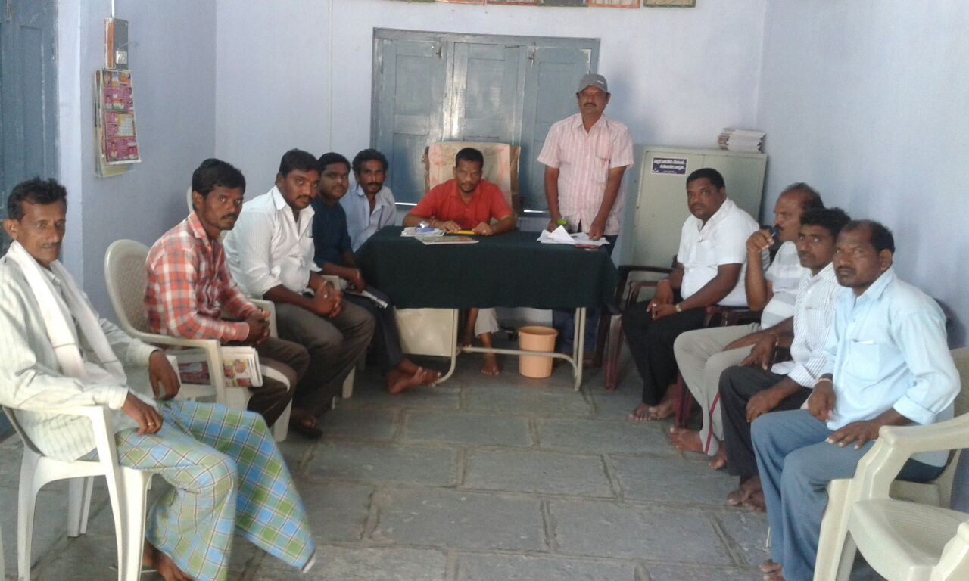
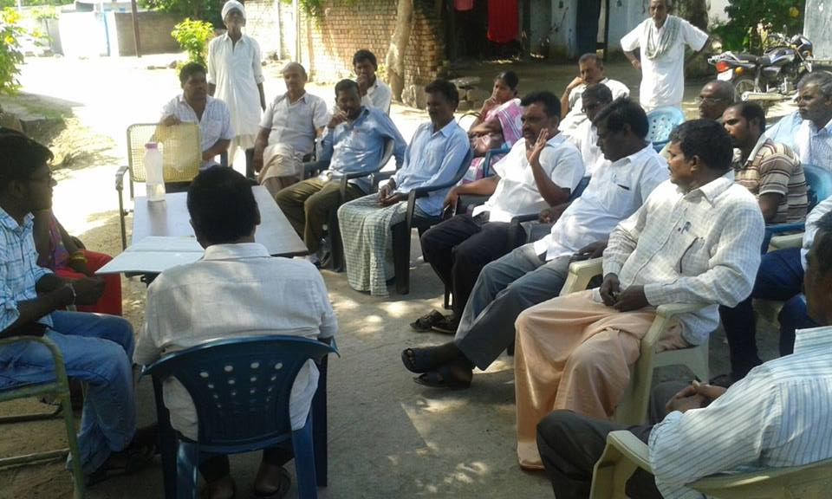
Stakeholder Consultations

Slide 8
Status of Spatial Plan Preparation
Sl No | Phase | Cluster | District | No of Revenue Villages | No of Manual Land Use Maps Prepared | Digitization |  |  | Remarks
 |  |  |  |  |  | No of .shp files available for Rev Villages | Digitization completed | Balance
1 | Phase-I | Allapur.S | Vikarabad | 33 | 33 | 27 | 27 | 0 | Spatial planning of unavailable .shp file villages have been prepared with TRAC village boundary, Google satellite and Topo sheets SoI and integrated in Cluster map
2 |  | Ryakal | Sangareddy | 38 | 38 | 38 | 38 | 0
3 |  | Jukkal | Kamareddy | 30 | 30 | 29 | 29 | 0
4 |  | Chirrakunta | K.B.Asifabad | 64 | 64 | 64 | 64 | 0
5 | Phase-II | Sulthanabad | Peddapally | 21 | 21 | 18 | 18 | 0
6 |  | Vennacherla | Nagarkurnool | 25 | 25 | 24 | 24 | 0
7 |  | Nagaram | Bhupalapally | 17 | 17 | 16 | 16 | 0
8 | Phase-III | Kondabheemana pally | Nalgonda | 27 | 27 | 27 | 27 | 0
9 |  | Kuntala | Nirmal | 15 | 15 | 15 | 15 | 0
10 |  | Bijigirisharif | Karimnagar | 18 | 18 | 18 | 18 | 0
11 |  | Papannapet | Medak | 26 | 26 | 26 | 26 | 0
12 |  | Jaligaon | Siddipet | 22 | 22 | 21 | 21 | 0
13 |  | Yedpalle | Nizamabad | 11 | 11 | 11 | 11 | 0
14 |  | Nancherla | Mahboobnagar | 52 | 52 | 41 | 41 | 0
15 |  | Choutuppal | Yadadri Bhuvanagiri | 26 | 26 | 26 | 26 | 0 | Completed (HMDA)
16 |  | Shankarpally | Rangareddy | 25 | 25 | 25 | 25 | 0 | Completed (HMDA)
Total : |  |  |  | 450 | 450 | 426 | 426 | 0

Slide 9
Progress of Map Preparation

Slide 10
Rykal Cluster: Location
Ryakal Location
East: Kangti Shankarampet (A) Mandal
North: Kalher & Sirgapur mandals
West: Nagalgidda Mandal
South: Manoor and Regode Mandals
Rykal
10

Slide 11
Rykal: Regional Setting
Area
219.70 sqkm
Population
57,365
Vision of the Cluster
agriculture and allied activities, Skill Development and ODF with Socio- Economic Development and Saturation of Basic Amenities
Market Linkage
Agriculture Consumer Market, Village Haats
Economic Activities
Dairy Development – Establishment of Bulk Milk Chilling Center

Slide 12
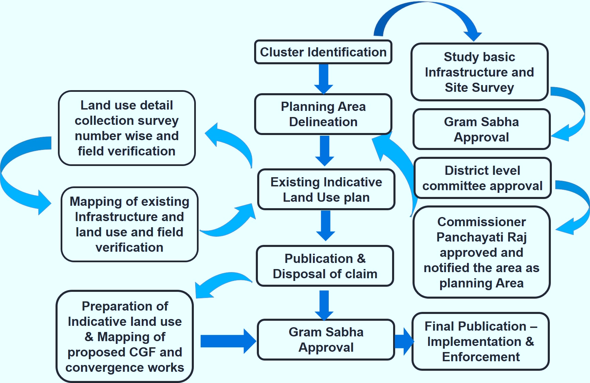
Spatial Plan Preparation Methodology

Slide 13
Map Preparation Methodology
Time period required three months with 23 Technical People for 450 villages
Output
Indicative Land Use
Infrastructure Mapping
Exiting and proposed Asset Mapping
Government and private land ownership
Input
Cadastral Map
Survey of India Map
Satellite Data
Survey
Process
Image mosaicking
Image processing
Geo referencing
Digitization
Attribution
Scale of Map : Village Map 1:4,000 & Cluster Map 1: 25,000

Slide 14
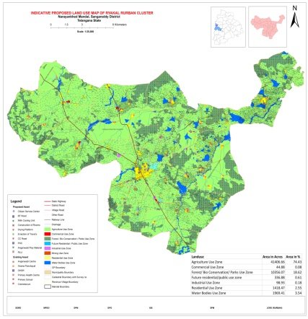
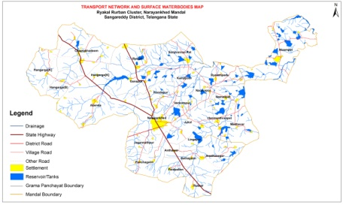
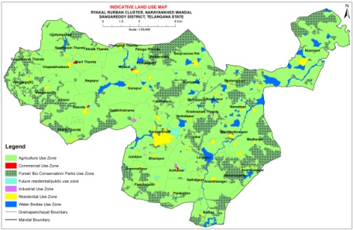
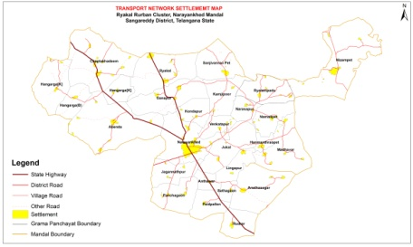
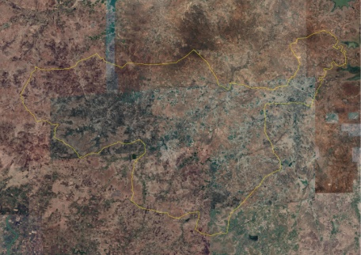
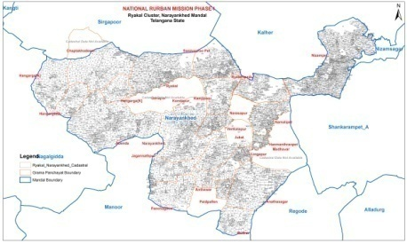
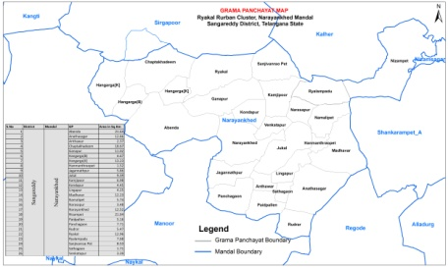
Spatial Plan
Proposal Maps
Thematic Maps
Existing Land Use Map
Base Map
Satellite Imagery
Cadastral Map superimposition
GP map

Slide 15
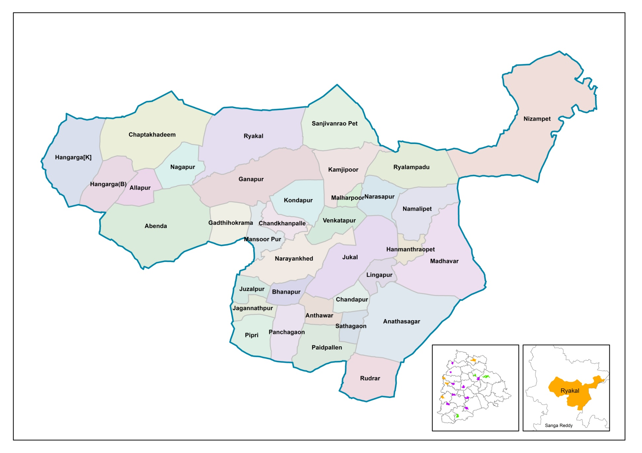
Rykal Cluster: Administrative Boundary

Slide 16
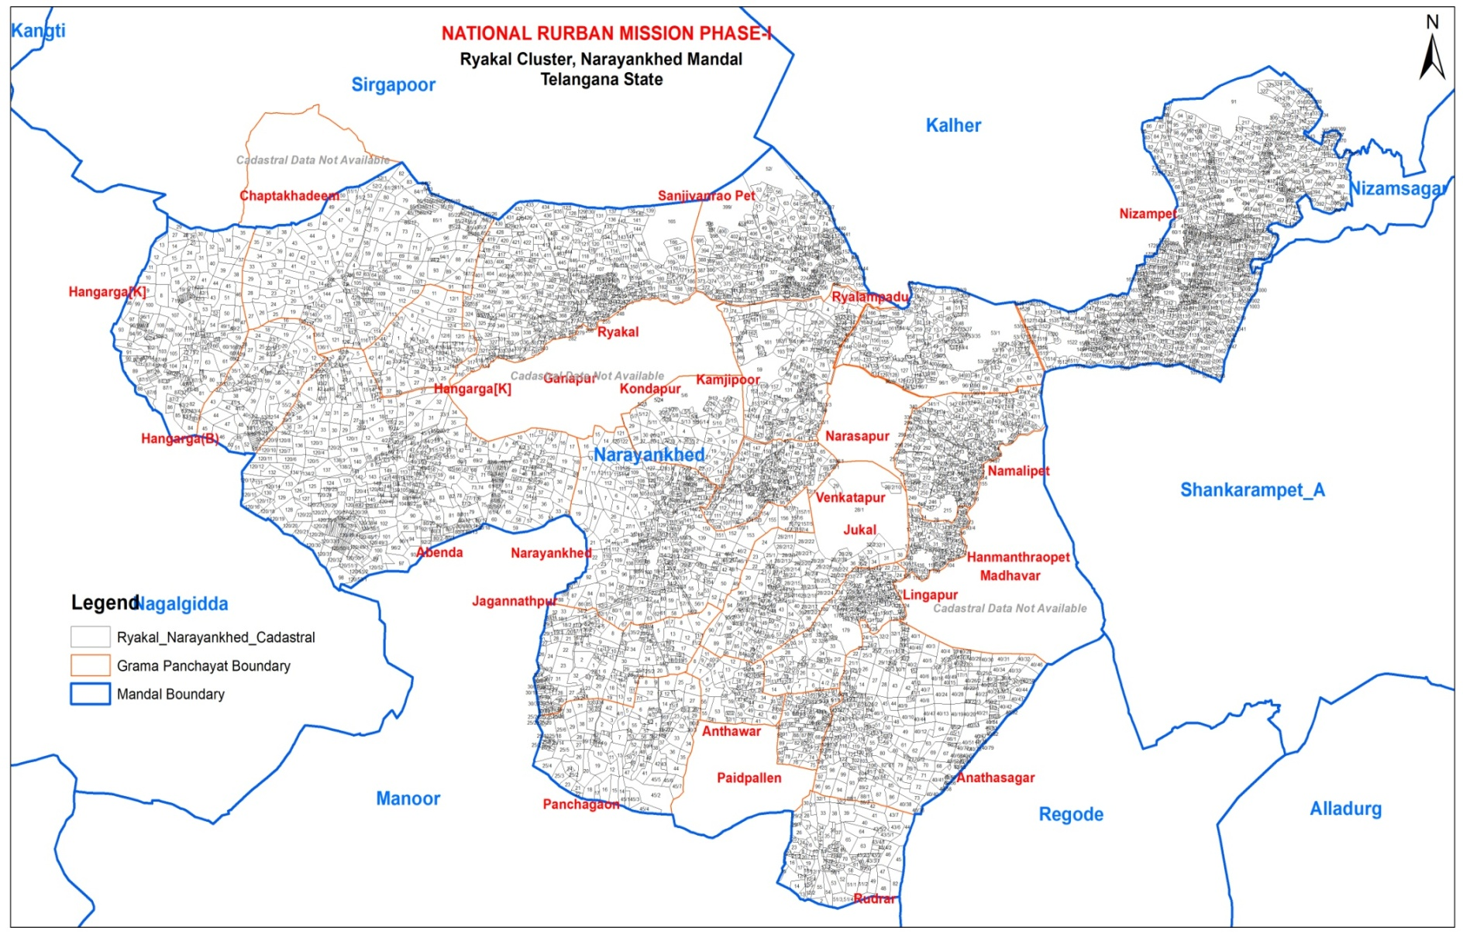
Rykal Cluster: Cadastral Map

Slide 17
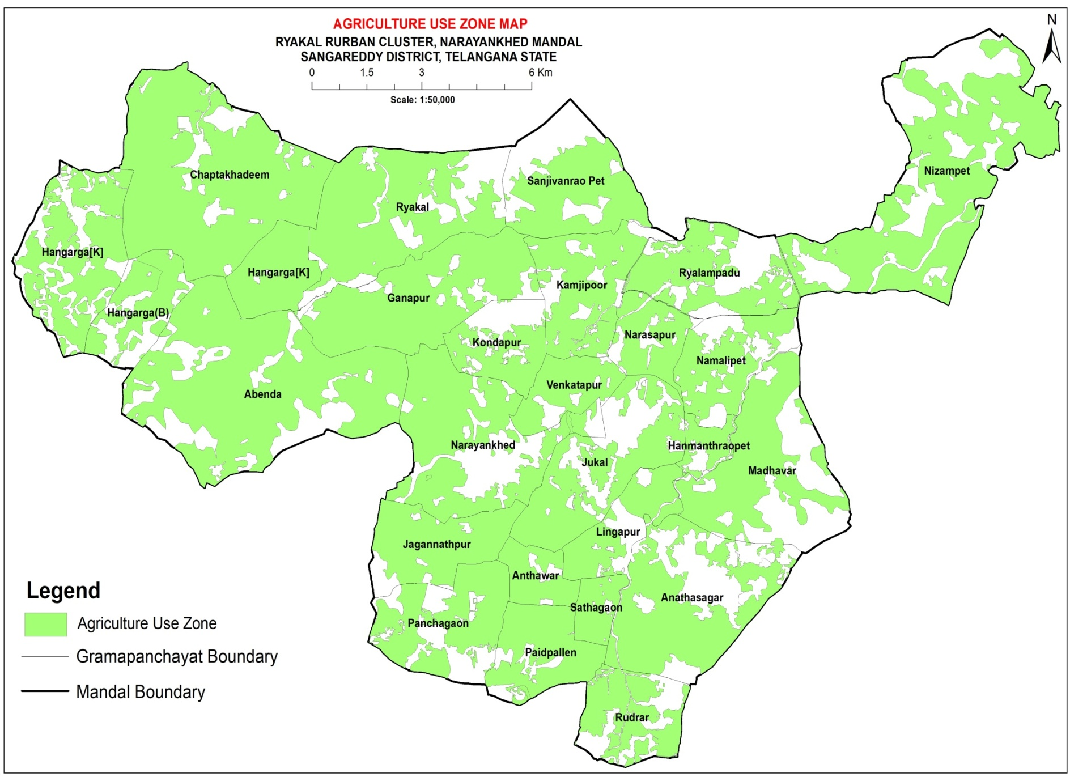
Rykal Cluster: Agriculture Land Use

Slide 18
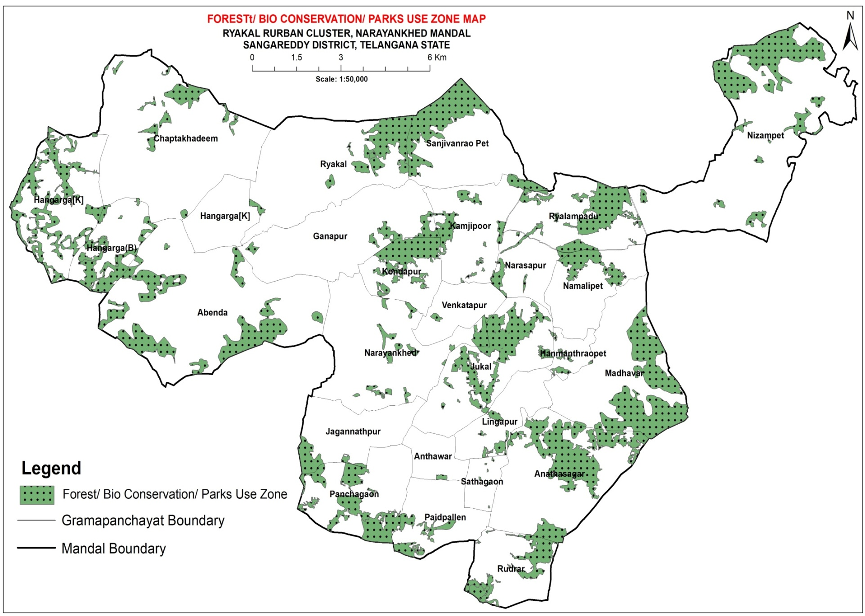
Rykal Cluster:
Forest/ Bio conservation/ Parks Zone

Slide 19
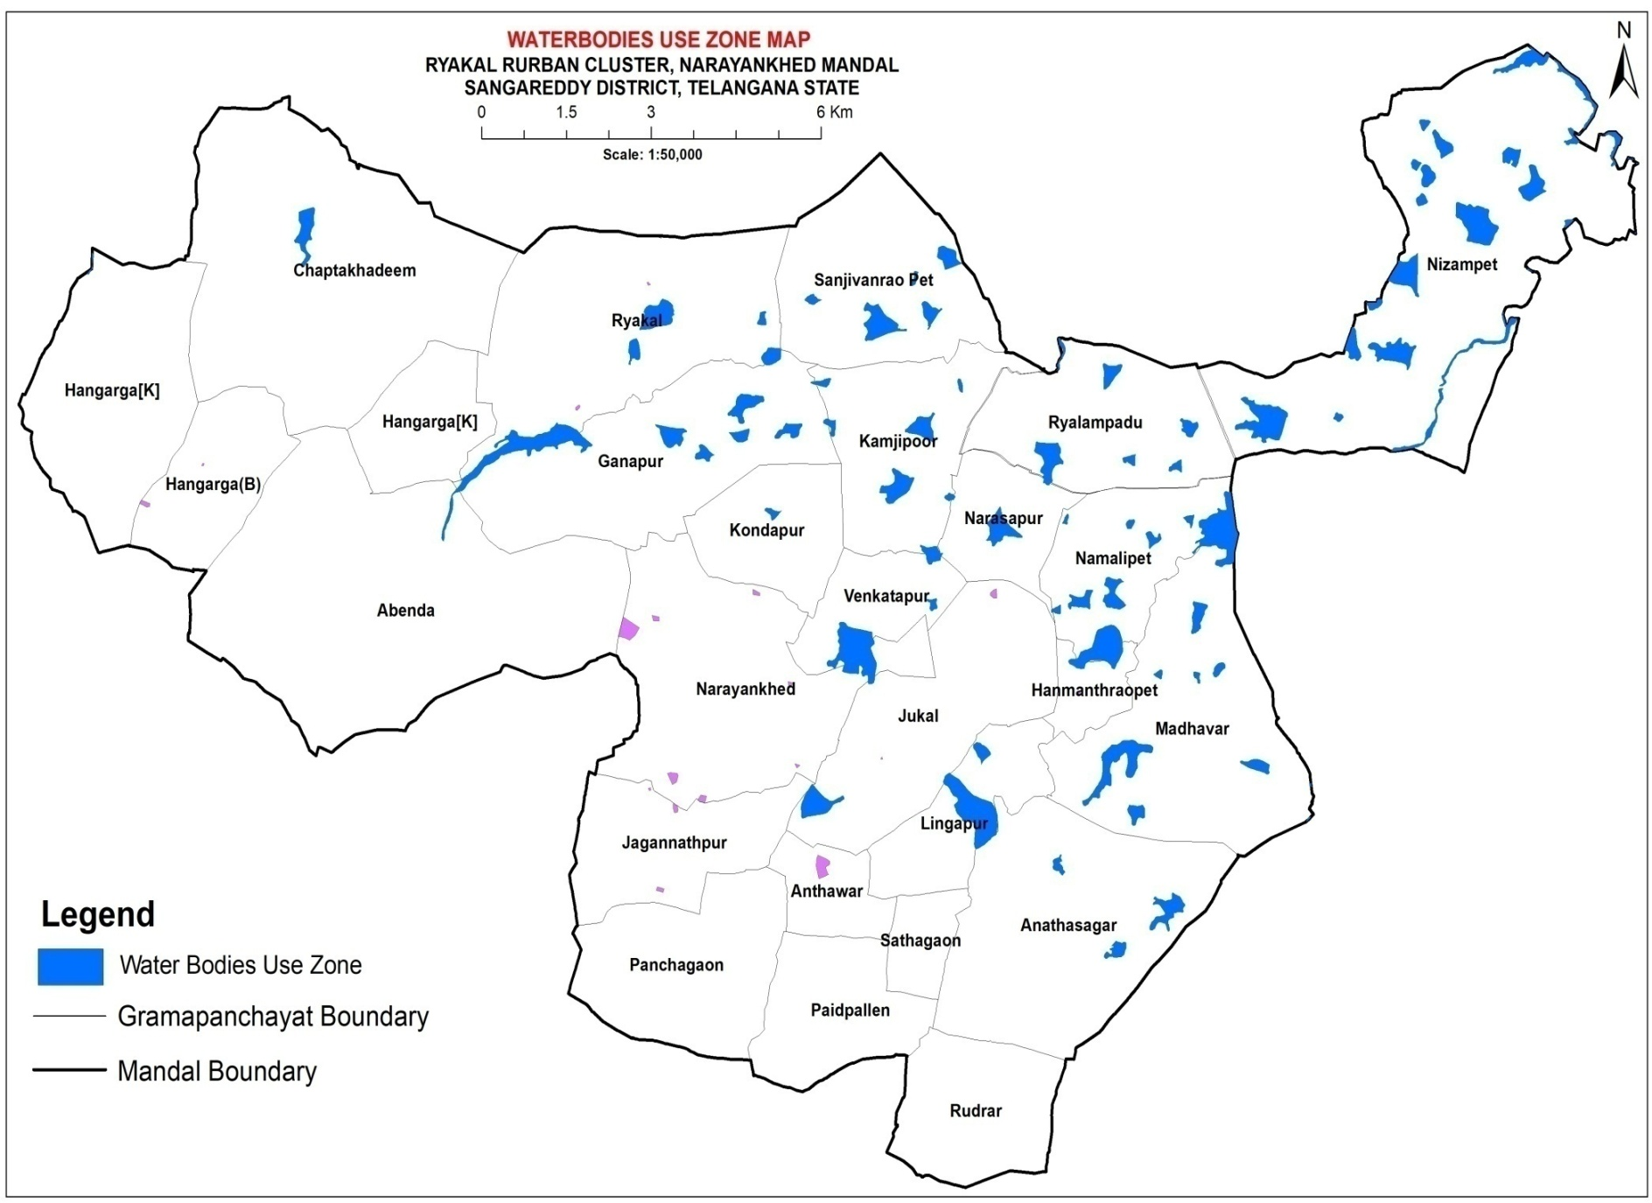
Rykal Cluster: Water Bodies Use

Slide 20
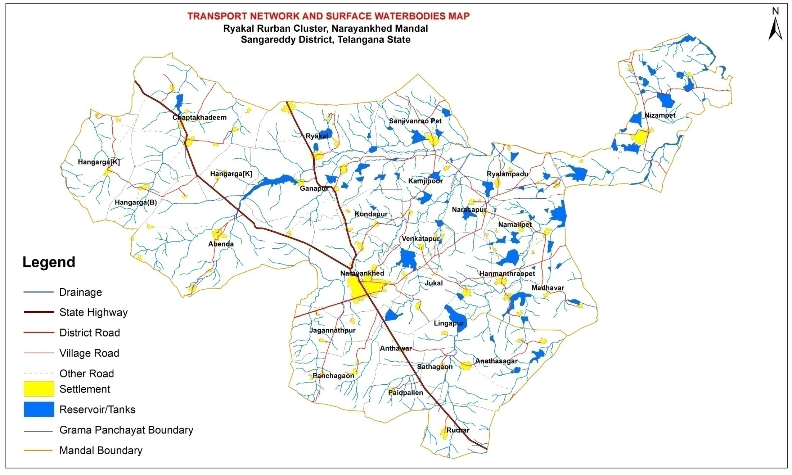
Rykal Cluster: Transport and Surface Water Bodies

Slide 21
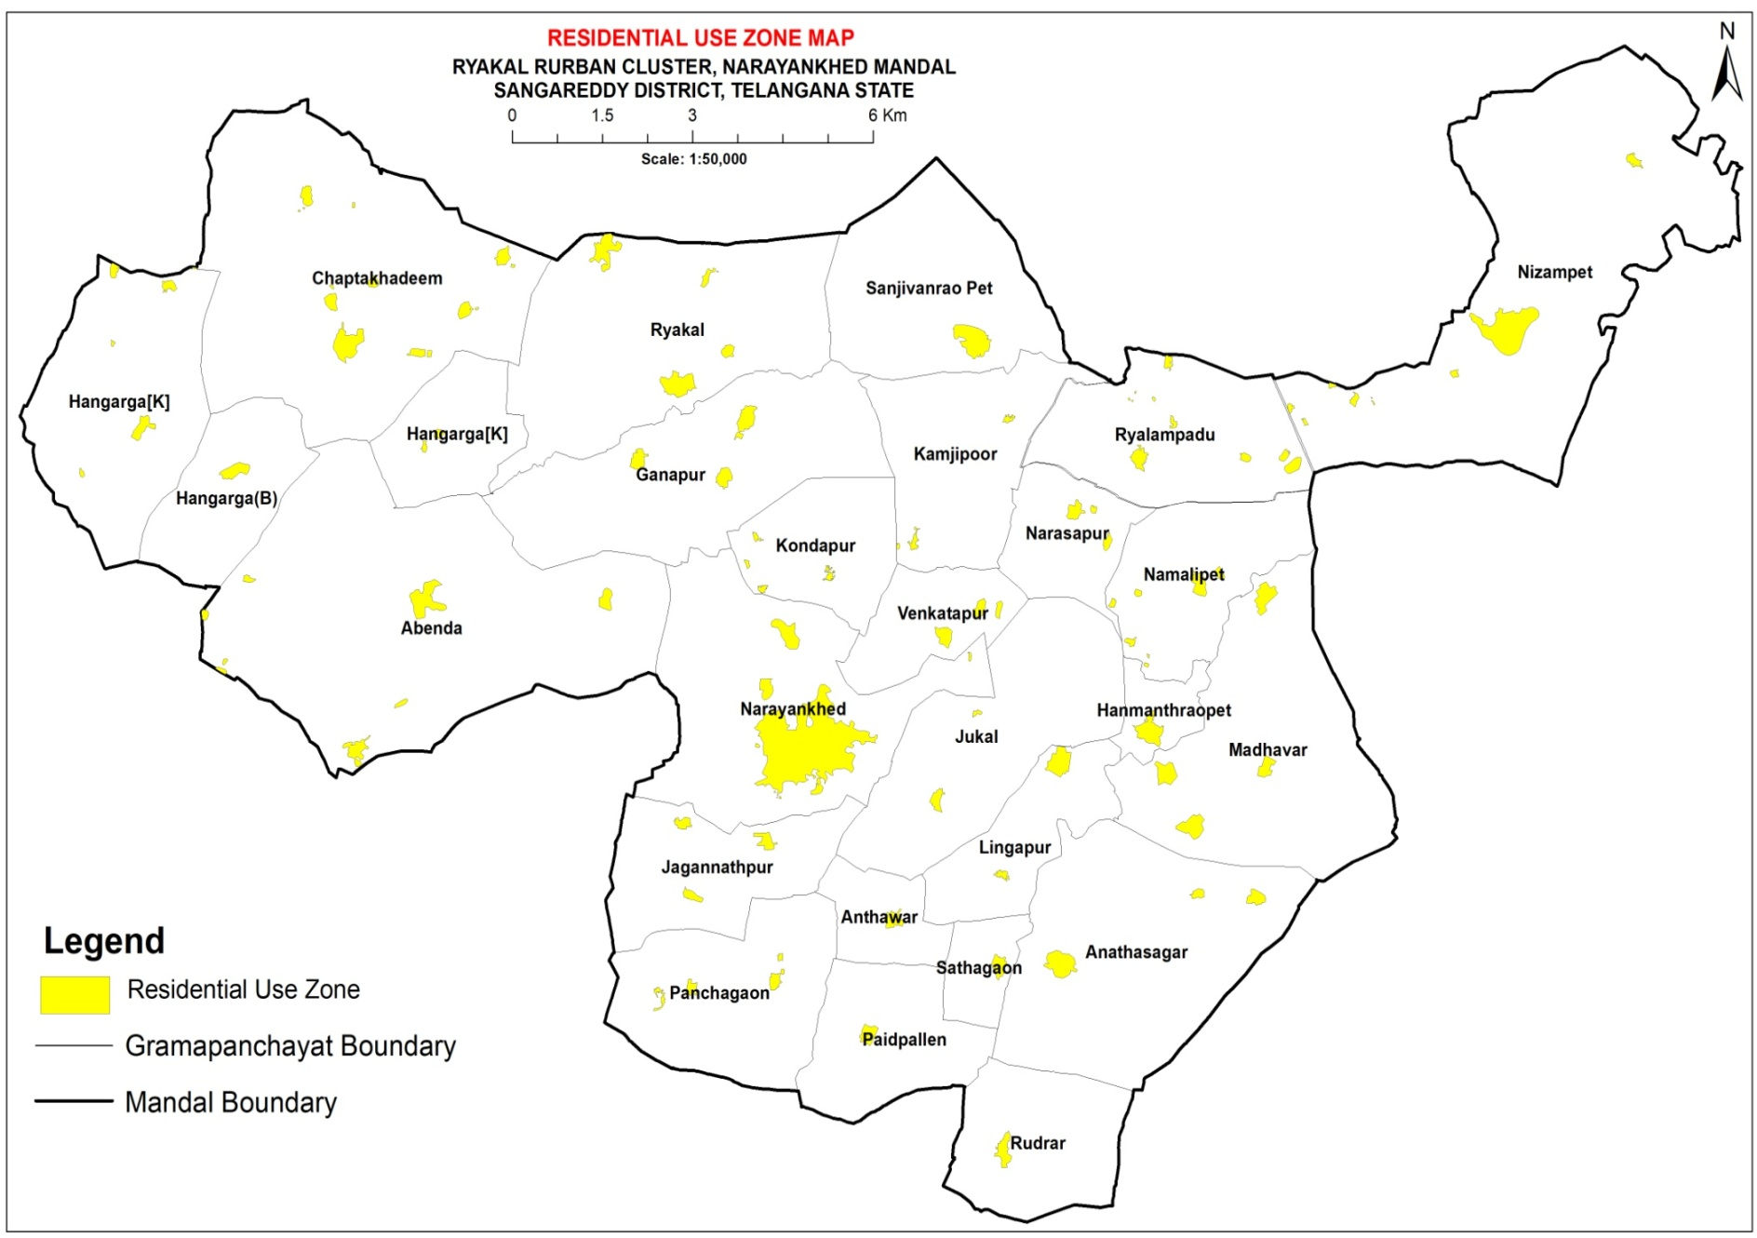
Rykal Cluster: Residential Land Use

Slide 22
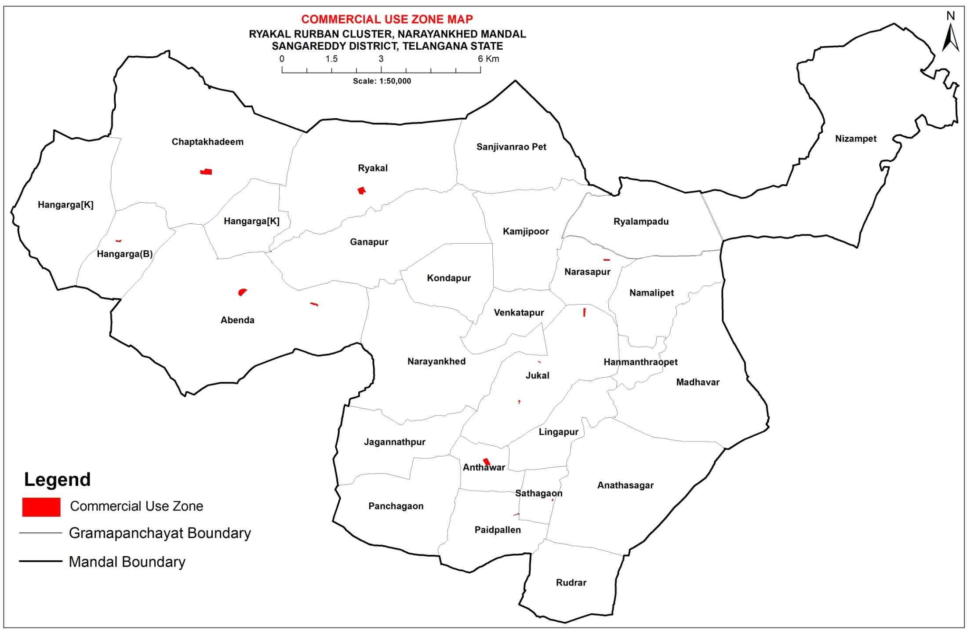
Rykal Cluster: Commercial use

Slide 23
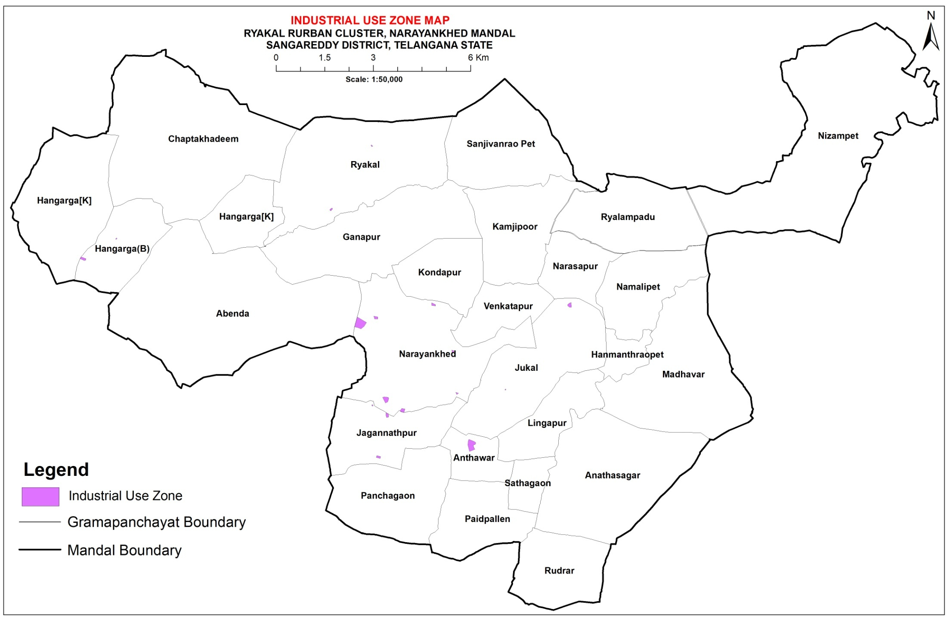
Rykal Cluster: Industrial Use

Slide 24
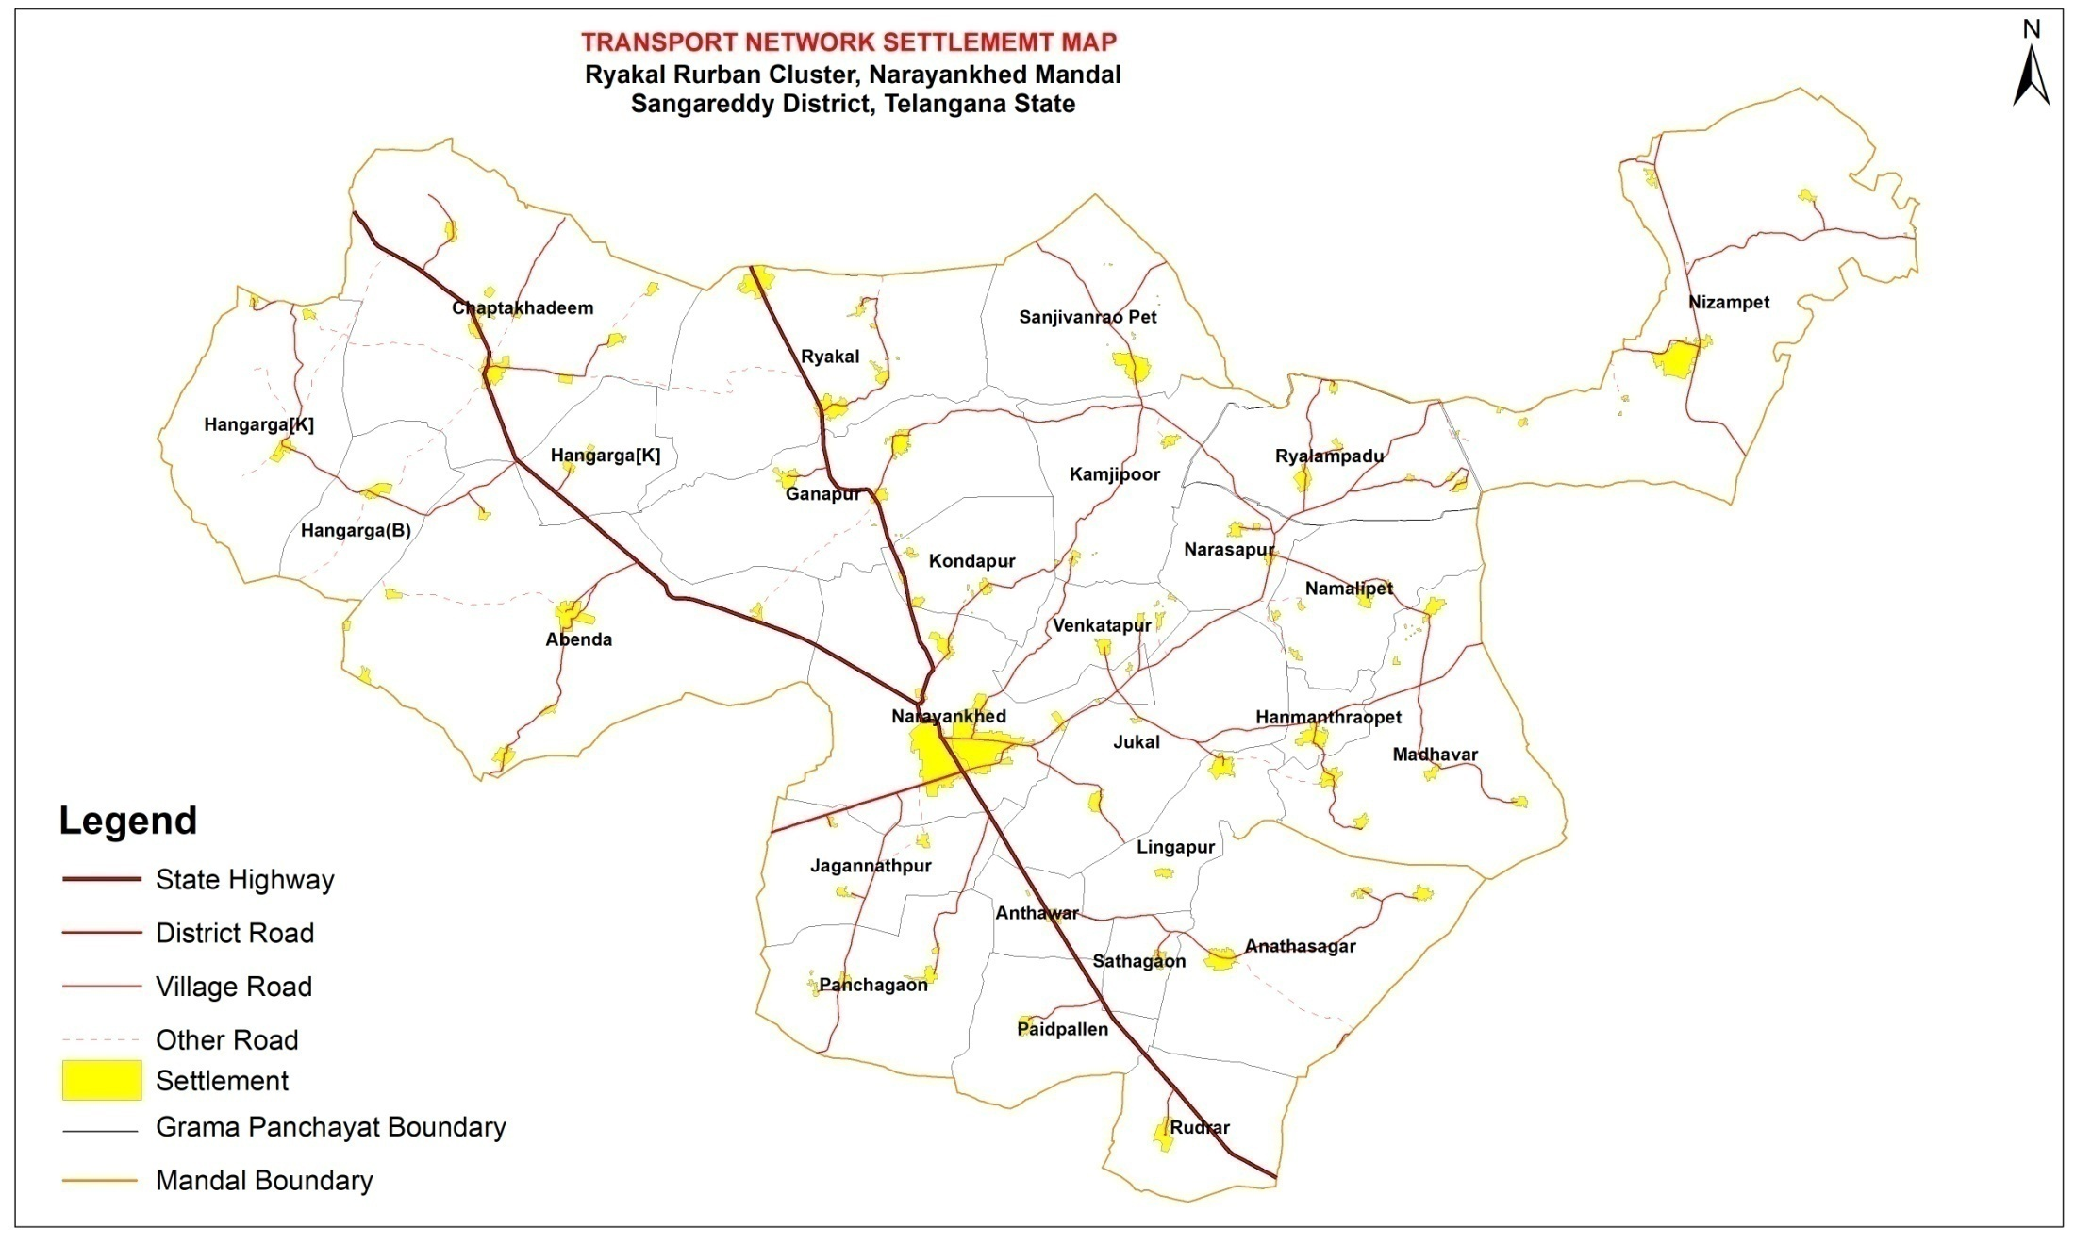
Rykal Cluster: Transport Network

Slide 25
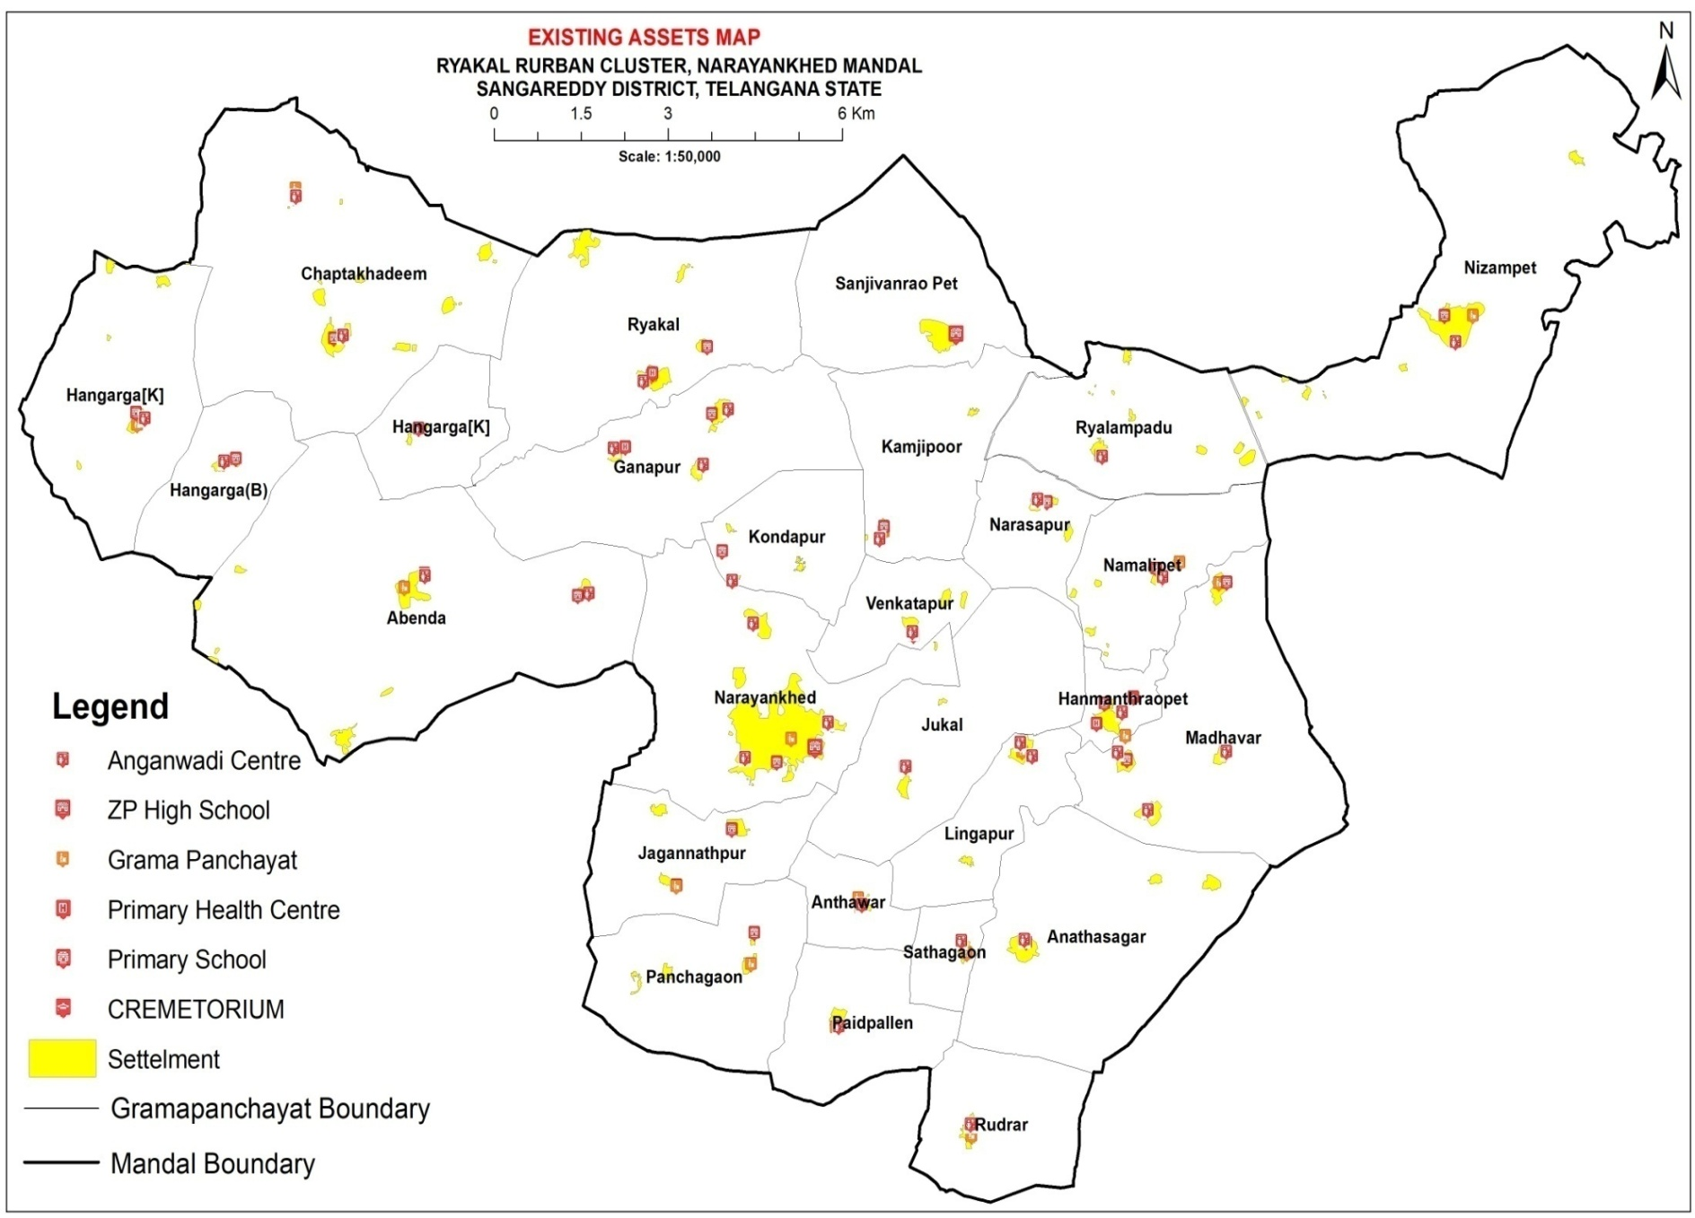
Rykal Cluster: Basic Infrastructure

Slide 26
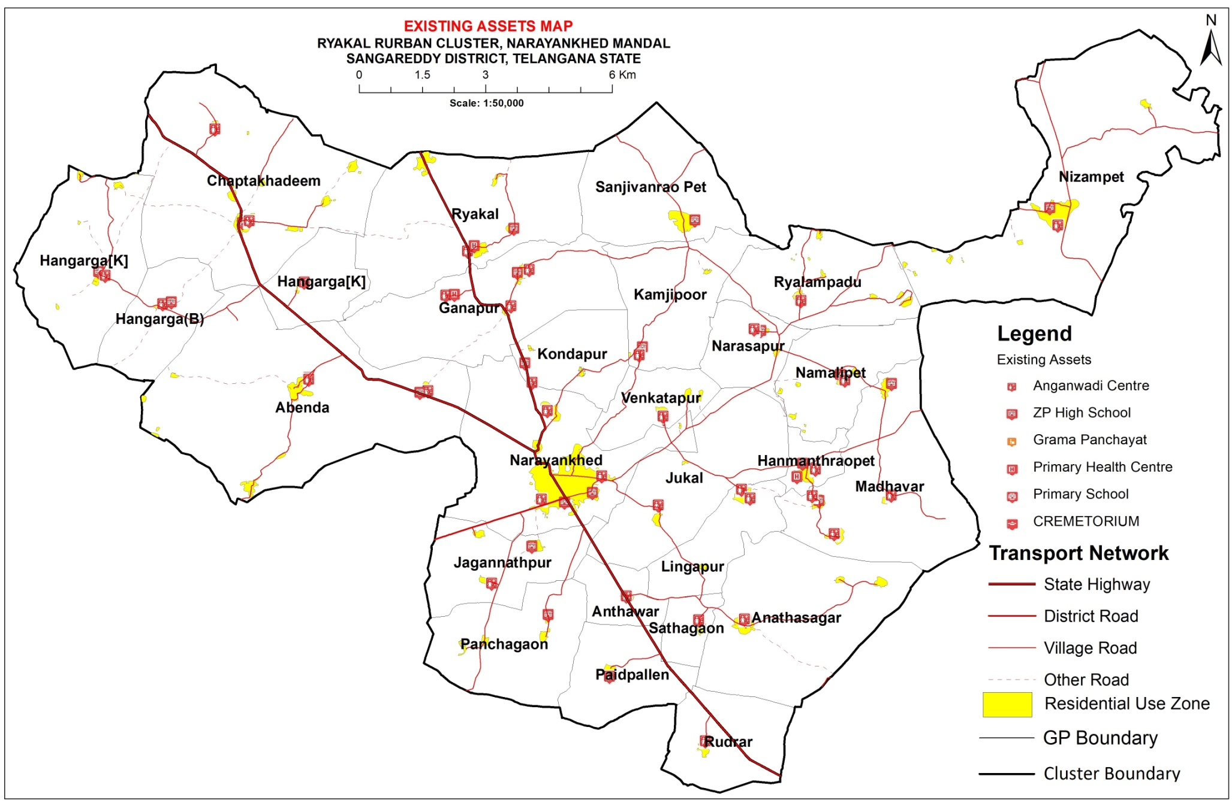
Rykal Cluster: Basic Infrastructure

Slide 27
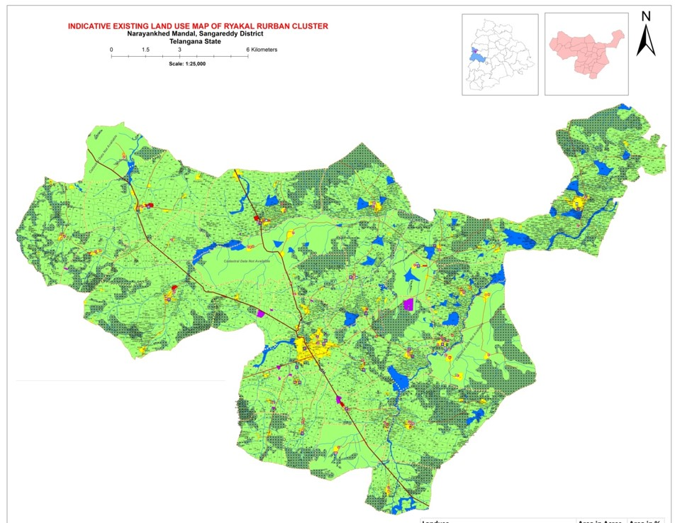
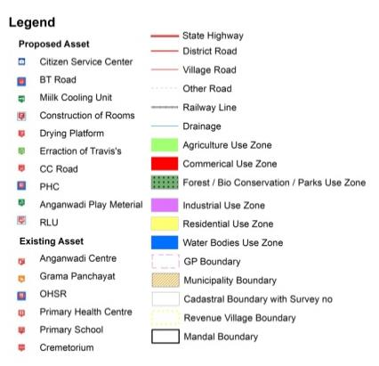
Rykal: Existing Land Use
Existing Land Use Layers
Polygon:
1. Residential Use Zone
2. Commercial Use Zone
3. Industrial Use Zone
4. Agriculture Use Zone
5. Forest/ Bio Conservation/ Parks Use Zone
6. Water Bodies Use Zone
Line:
7. Drainage
8. Transport Network
Point:
9. Existing Infra structure
10. Proposed Works
Area Statement
Landuse | Area in Acres | Area in %
Agriculture Use Zone | 41662.25 | 74.89
Commercial Use Zone | 44.88 | 0.08
Forest/ Bio Conservation/ Parks Use Zone | 10437.36 | 18.76
Industrial Use Zone | 98.93 | 0.18
Residential Use Zone | 1418.47 | 2.55
Water Bodies Use Zone | 1969.41 | 3.54

Slide 28
Demand Gap Analysis & Projections
Sl. No | Component Type | Component Name | Unit | Desired Level | Existing Level | Deficit | Gap/ Projected Percentage
1 | Basic Amenities | Piped Water Supply |  | 100 | 40 | 60 | 60
2 | Basic Amenities | Sanitation |  | 16916 | 4591 | 12325 | 72.86
3 | Basic Amenities | Solid and Liquid Waste Management |  | 100 | 0 | 100 | 100
4 | Basic Amenities | Access to Village Streets with Drains |  | 379 | 82 | 297 | 78.36
5 | Basic Amenities | Village Street Lights and Electrification |  | 7840 | 3539 | 4301 | 54.86
6 | Basic Amenities | Inter village roads connectivity |  | 111 | 20 | 91 | 81.98
7 | Basic Amenities | Public Transport |  | 27 | 18 | 9 | 33.33
8 | Basic Amenities | LPG Gas Connenction |  | 16916 | 2475 | 14441 | 85.37
9 | Economic Activities | Skill Development training Linked to Economic Activities |  | 11841 | 230 | 11611 | 98.06
10 | Economic Activities | Agri-services Processing and allied activities |  | 100 | 11 | 89 | 89
11 | Social Amenities | Education |  | 347 | 145 | 202 | 58.21
12 | Social Amenities | Health |  | 19 | 14 | 5 | 26.32
13 | Digital Amenities | Digital Literacy |  | 100 | 0.91 | 100 | 100
14 | Digital Amenities | Citizens Service Centres |  | 27 | 1 | 26 | 96.3

Slide 29
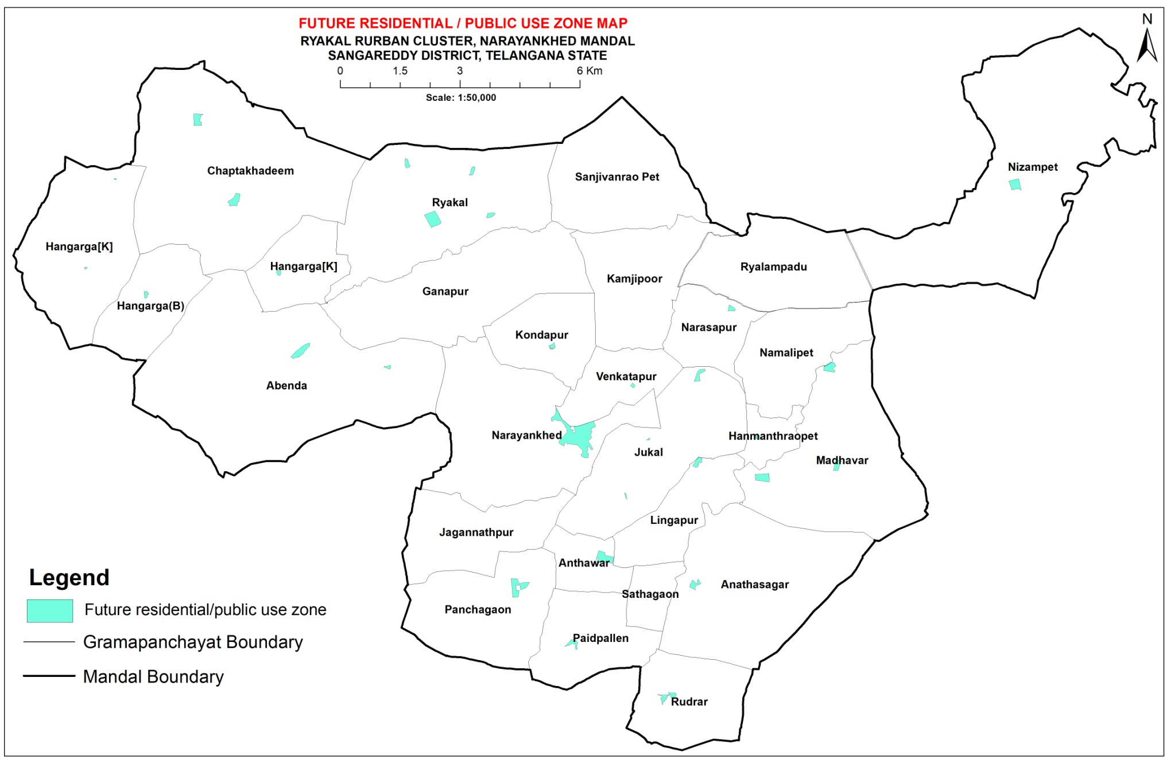
Rykal: Future Residential / Public Use zone

Slide 30
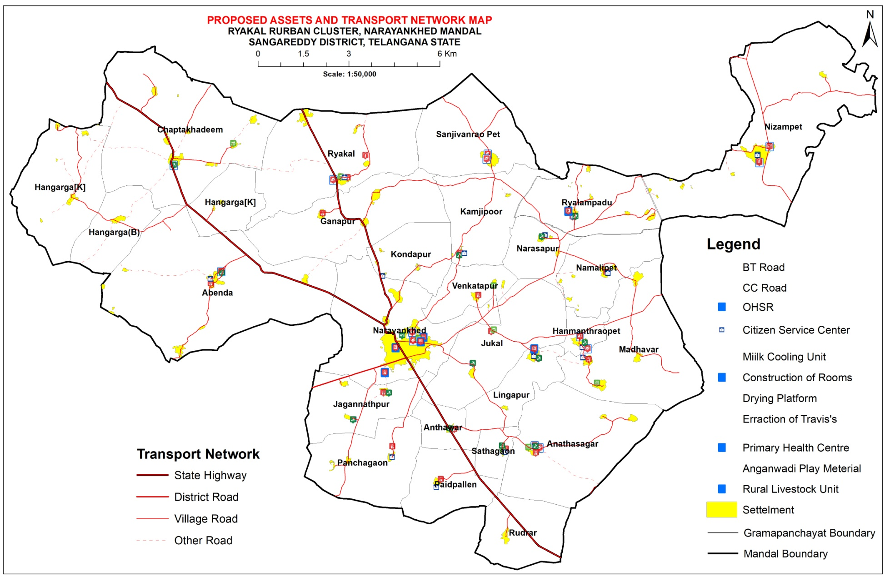
Rykal: Proposed Asset

Slide 31
Spatial Plan: Proposed Indicative Land Use
ICAP Project layers
1 | Acess to village streets with drains
2 | Agri services processing and allied activities
3 | Citizen service centres
4 | Digital literacy
5 | Education
6 | Environment
7 | Health
8 | Inter village roads connectivity
9 | Piped water supply
10 | Public transport
11 | Sanitation
12 | Skill development training linked to economic activities
13 | Social infrastructure
14 | Social welfare
15 | Solid and liquid waste management
16 | Village street lights and electrification
Landuse | Area in Acres | Area in %
Agriculture Use Zone | 41406.25 | 74.43
Commercial Use Zone | 44.88 | 0.08
Forest/ Bio Conservation/ Parks Use Zone | 10356.07 | 18.62
Industrial Use Zone | 98.93 | 0.18
Residential Use Zone | 1418.47 | 2.55
Future Residential/ Public use zone | 336.88 | 0.61
Water Bodies Use Zone | 1969.41 | 3.54

Slide 32
Implementation & Enforcement

Slide 33
Way Forward
Zoning regulation is being prepared and will be notified along with Master plan

Slide 34
Thank you

